Slide 1
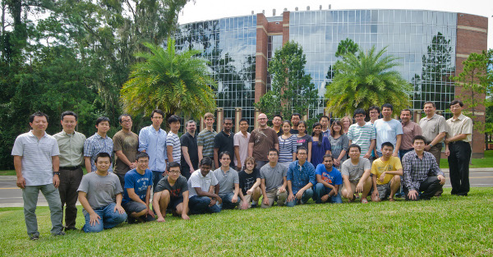

The case for ACIS @ UF in PRAGMA
Jose Fortes
(also on behalf of
Renato Figueiredo and Reed Beaman)

Slide 2
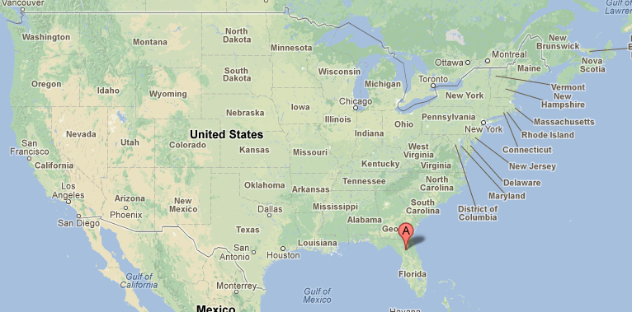

Slide 3
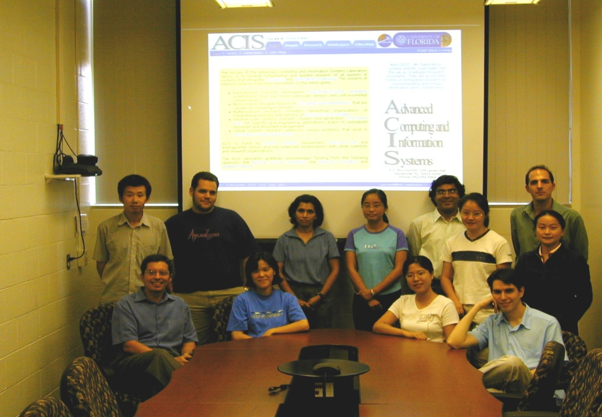
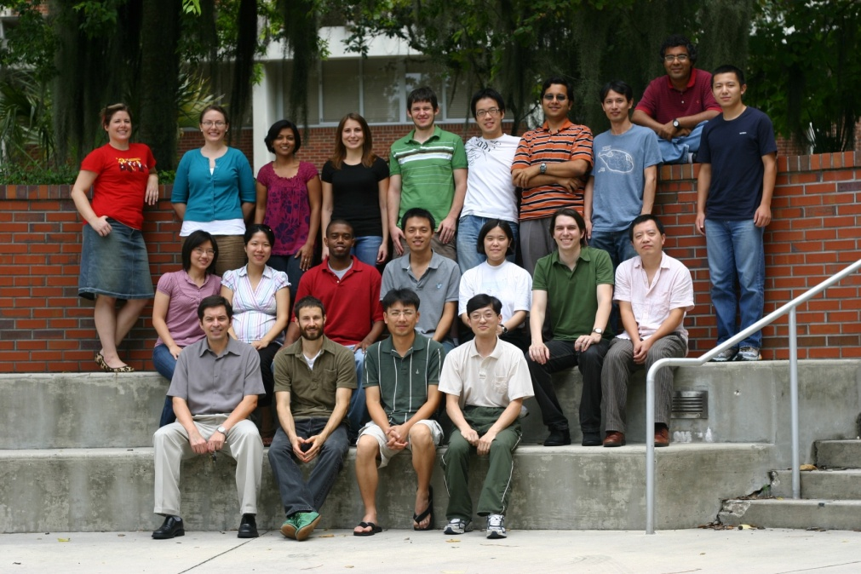
ACIS in numbers
Founded in 2001
2 + 2 faculty members
3 research scientists
2 IT experts
1 Assistant, 1 secretary
20 PhD students
3 PhD graduates/year
Visitors from Japan, Korea,
China, France, Thailand …
More than 15 papers/year
1⁺ keynote speech/year
Chair one⁺ meeting per year
$1 to $1.5 M/year expenditures

Slide 4
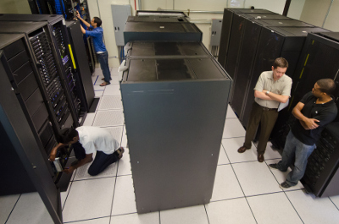
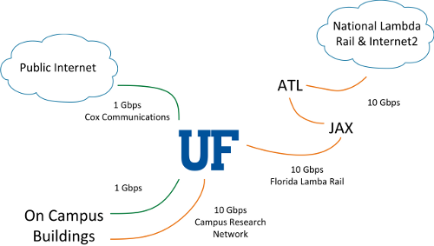
ACIS Facilities
State-of-the-art computing, storage and networking facilities
Unique environment for experimental research and design of distributed systems that use virtualization software developed by commercial and open-source projects
~200 servers, ~1250 cores, ~4.8TB memory, ~260TB storage
FutureGrid cluster: IBM iDataPlex connected to Florida Lambda Rail.
NUMAcloud: up to 64 cores+512MB of memory in a single image
Autonomic Testbed: autonomics for datacenter management
VM and cloud: rich set of VMMs and cloud software
Storage: centralized (IBM DS4800) and cloud-based (OpenStack)

Slide 5
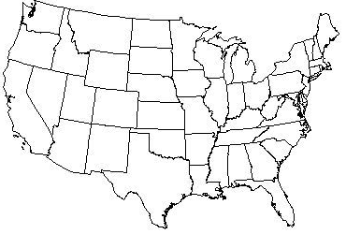
Center for Cloud and Autonomic Computing
Started 1/2008, NSF award
Four universities
Application domains
Defense & Gov
Health IT
Science
Critical infrastructure
Industry members
Defense & Gov
Platform & Software
IT Services
~ 15 industrial members
Raytheon, Intel, Xerox, Citrix,
Microsoft, ERDC, Avirtec, Samsung...

Slide 6

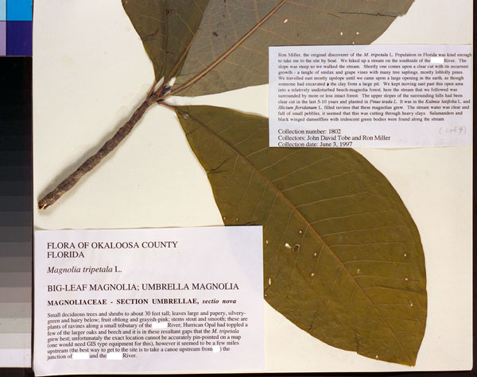
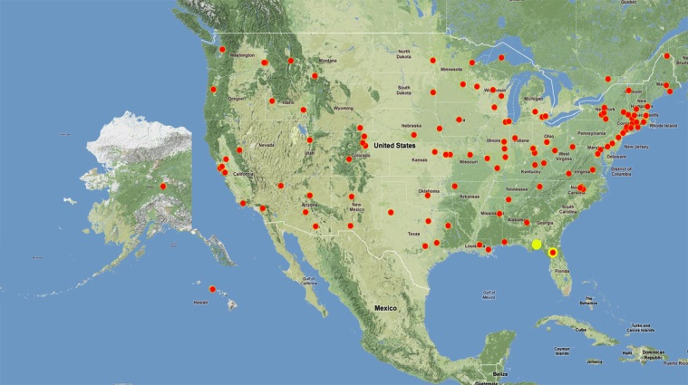
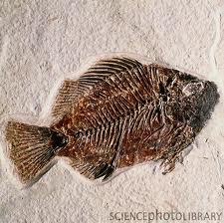
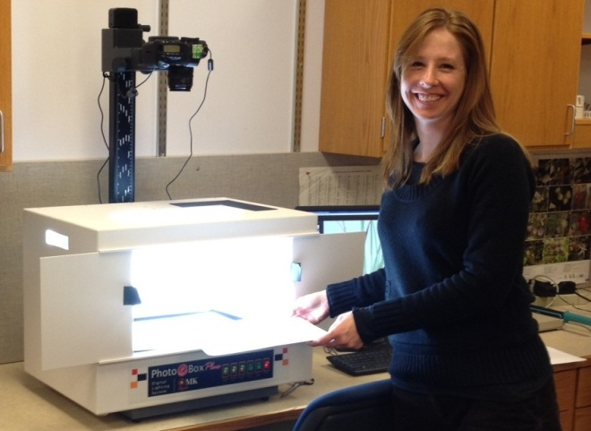
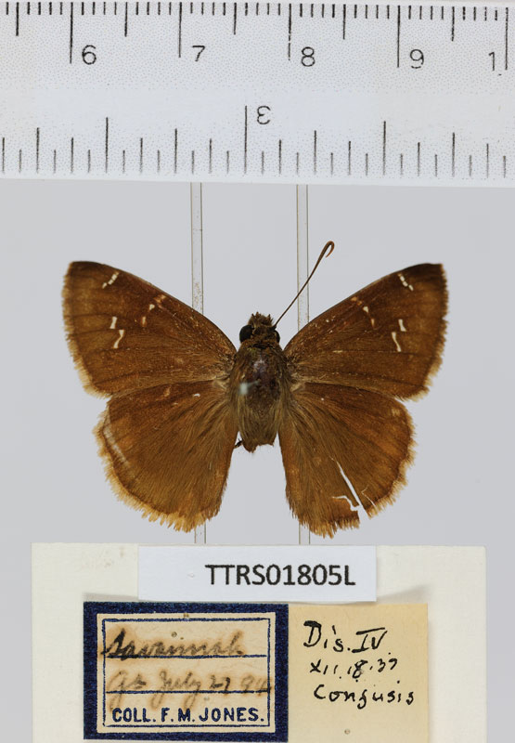
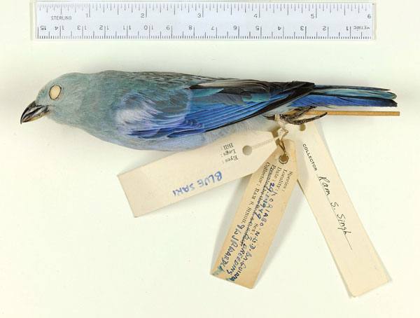
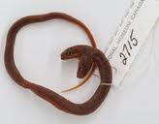



(2011-2016-2021)
PIs: L. Page, J. Fortes, P. Soltis, B. McFadden, and G. Riccardi

Slide 7
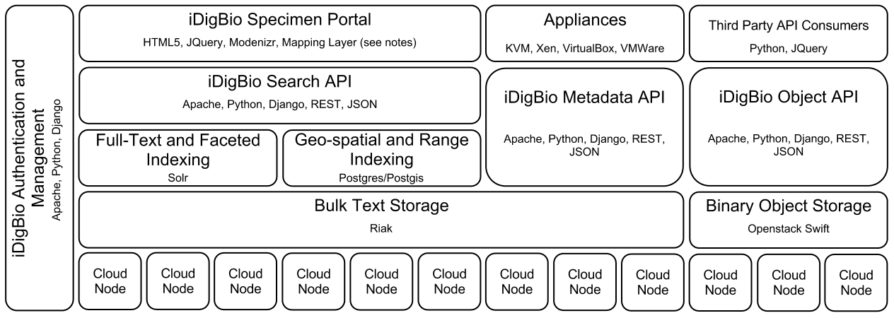
iDigBio IT Vision
Cyberinfrastructure to enable
the collaborative creation, integration and management of digitized biocollections, and
their use in scientific research, education and outreach.
Visible as a collection of persistent Internet-accessible services, data and resources (i.e. a cloud) for
biocollection “producers”, “consumers” and “service providers”
cyberinfrastructure providers
national/global data aggregators

Slide 8
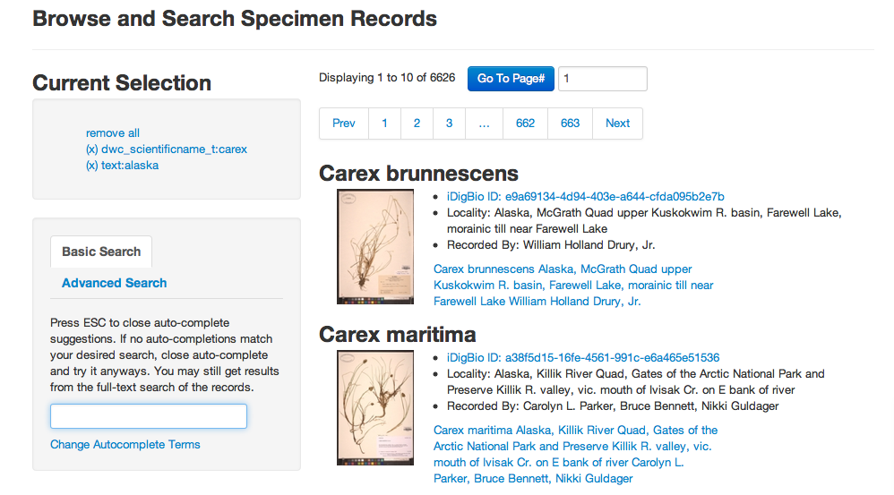
iDigBio data portal v0: search

Slide 9
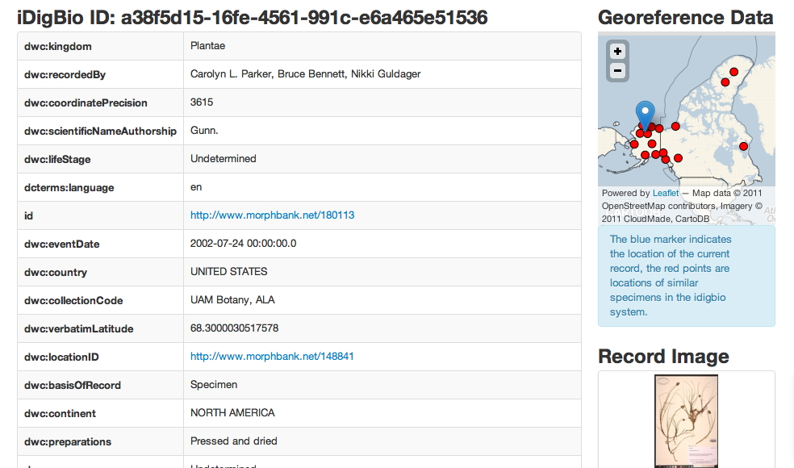
iDigBio data portal v0: record info

Slide 10


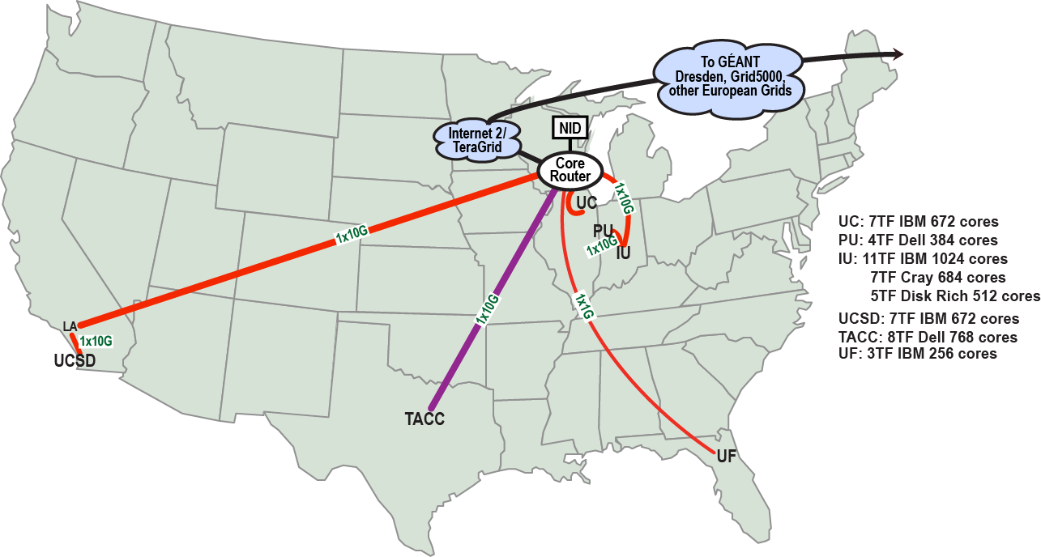
2009-2013 (OCI-0910812)
FutureGrid is an international testbed that supports computer science and computational science research in cloud, grid and parallel computing (HPC)
Provides a flexible development and testing platform for middleware and application users looking at interoperability, functionality, performance or evaluation, and a rich education and teaching platform for advanced cyberinfrastructure classes
PIs: Geoffrey Fox, Shava Smallen, Philip Papadopoulos, Katarzyna Keahey, Richard Wolski, José Fortes, Ewa Deelman, Jack Dongarra, Piotr Luszczek, Warren Smith, John Boisseau, and Andrew Grimshaw
Private Public
http://futuregrid.org

Slide 11
UF Roles in FutureGrid
Middleware, teaching, education and outreach with emphasis on overlay networks and virtual appliances.
Lead operations, and education and outreach teams
UF FutureGrid hardware: IBM iDataPlex – 256 cores, 768GB of RAM, 20TB of storage
Virtual Network (ViNe) project
Need: Enable communication among clouds overcoming limitations by firewalls
Objective: Develop an easy to manage intercloud communication infrastructure
Case Study: Interconnect VMs deployed on different FutureGrid clouds.

Slide 12
International collaborations
IT Virtualization for Disaster Mitigation and Recovery (ACIS/US + AIST/Japan)
NSF/JST-Funded Project from 2012 to 2013
Enabling continued operation of IT services and infrastructures during floods and other disasters (ACIS/US+TU/Thailand)
NSF/ Thailand Research Fund -Funded Project from 2012 to 2013
Enabling Scientific Expeditions and Infrastructure Experimentation for Pacific Rim Institutions and Researchers (PRAGMA)
NSF 2012-2017 + Multiple country research agencies
Model-based Autonomic Cloud Computing Software (UF&NWU/US + PKU&NU&FU/China)
NSF +NSFC (2013-2014)

Slide 13
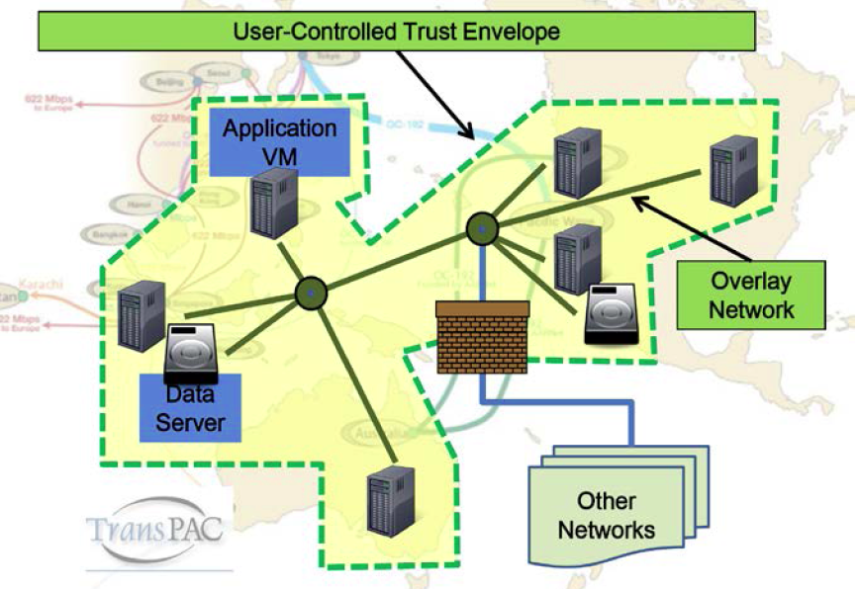
Grassroots international CI
VM Migration, images
and clusters
Overlay network
experiments
Data cloud
Observing systems
Virtual expedition
Adaption in extreme environments (Mount Kinabalu)
Importance of Trust Envelop
Infrastructure that initially limits access to data
Traverse firewalls and simplify network re-configuration of application VMs

Slide 14
Summary
Quick overview of main research activities at ACIS
Strong systems orientation
Novel concepts/theory, first-time prototypes, domain-specific production systems
Students do it all!
Many opportunities for international collaboration
CAC has international members
iDigBio plans to integrate/provide data from/to international collections
FutureGrid accepts international requests for projects
Separate projects
PRAGMA workshops, projects and members
Expand and magnify ACIS work

Slide 15
PRAGMA and ACIS@UF
A win-win partnership

